Slide 1
iCatching
An Automated Soft Robot Catcher
Tom Queen
Daniel Turner
Demetrius Zaibo

Slide 2
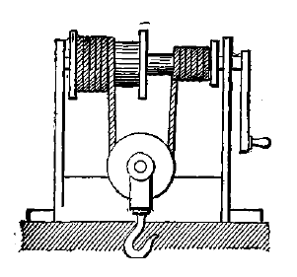
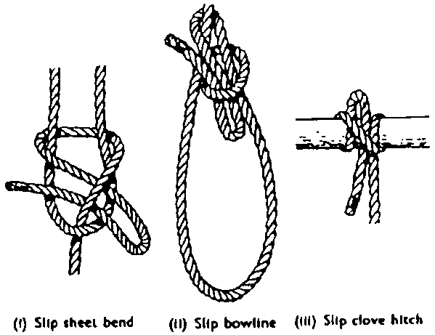
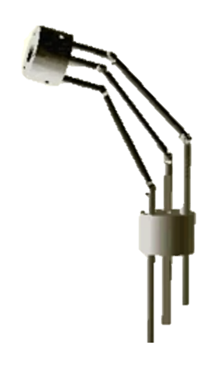
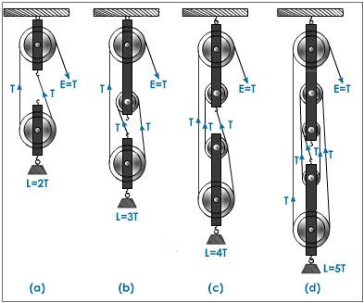
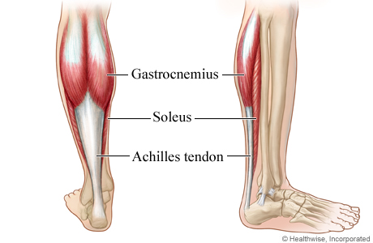
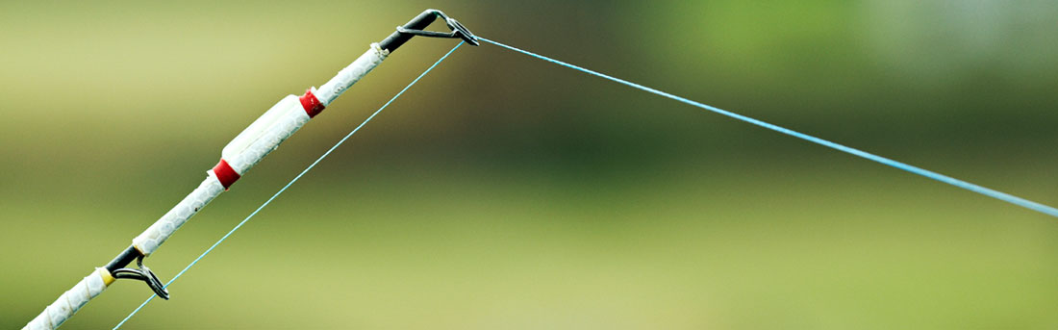
Cable Driven Machines
Cables typically serve three roles
Power to speed transfer
Windlass
Pulleys
Manipulation from afar
Quick release mechanisms
Fishing line
Antagonistic control
Muscles & Tendons
Surgical Manipulator

Slide 3
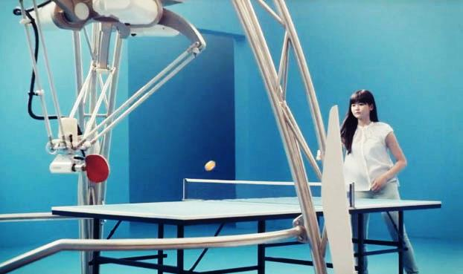
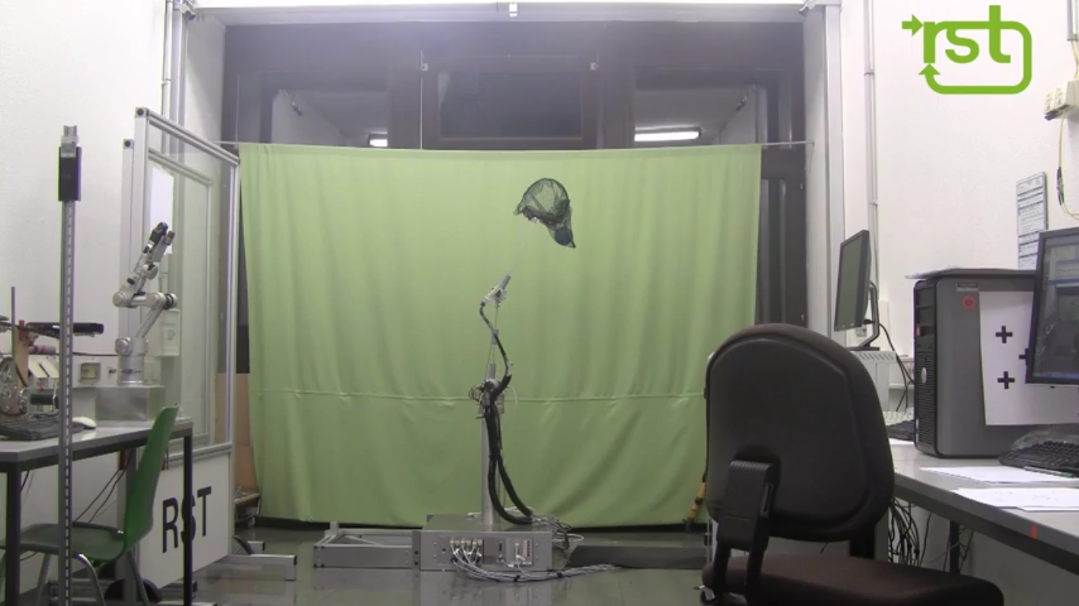
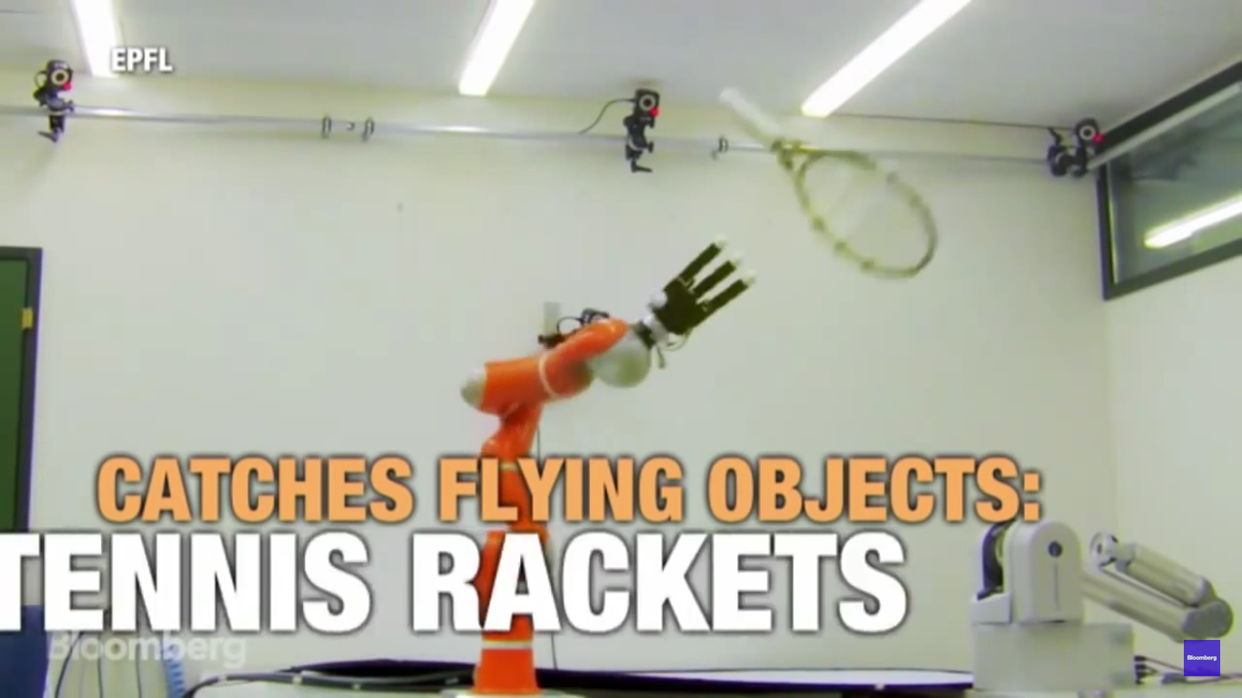
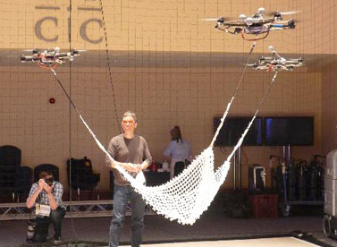
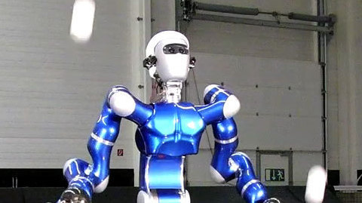
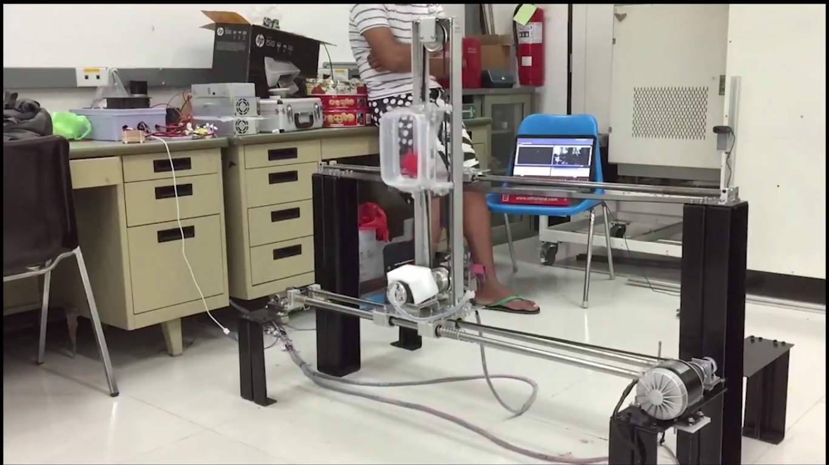
Previous Catcher-Bots
Table tennis: nearly catcher-bots
Humanoid / Robot Arm: highly complex, but possibly able to adapt more readily
Quadcopter: Highly versatile, and as complex as humanoids. Using a hammer to crack an egg
2D catchers: Much simpler
Double inverted pendulum
2D frame

Slide 4
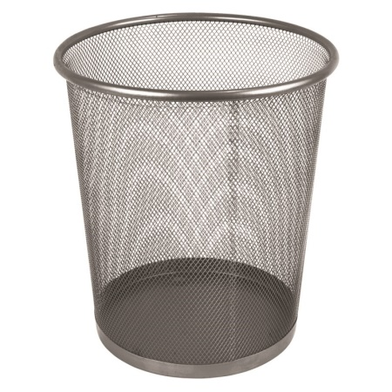
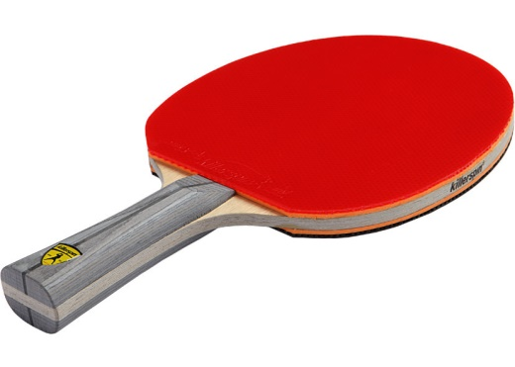
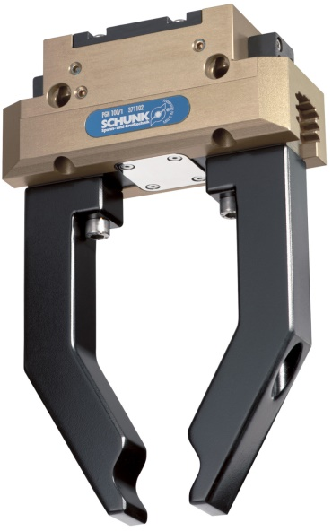
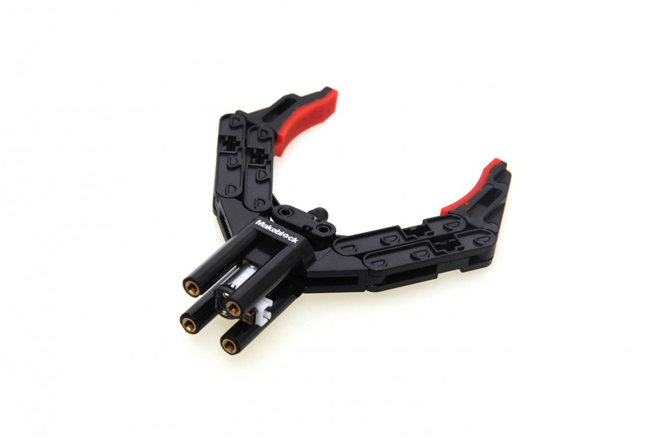
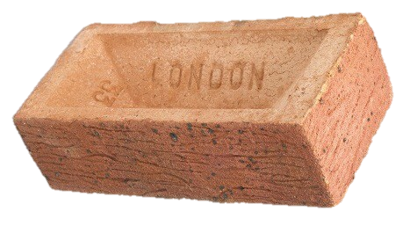
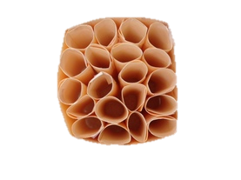
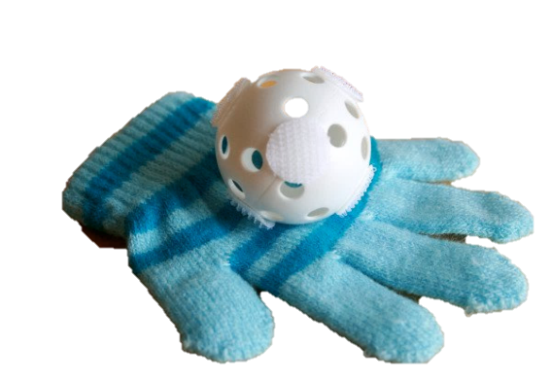
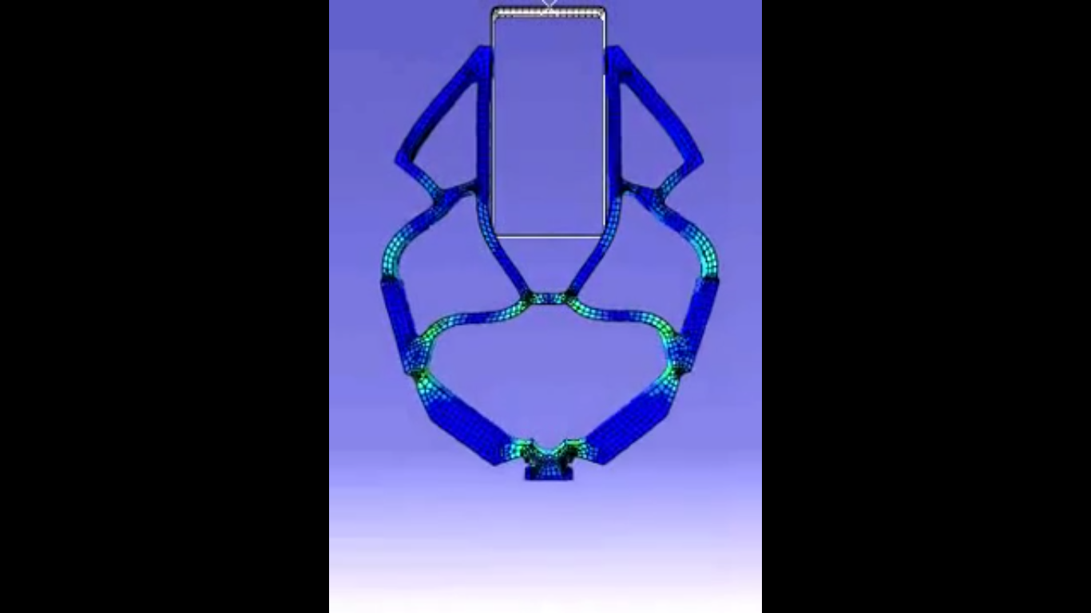
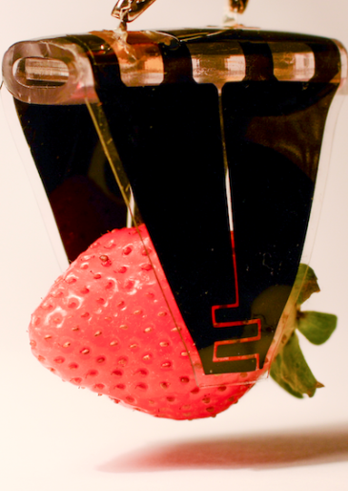
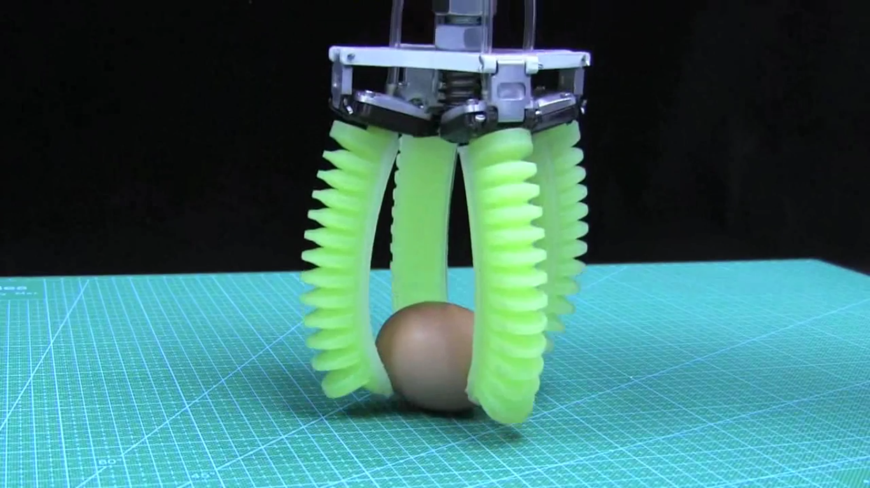
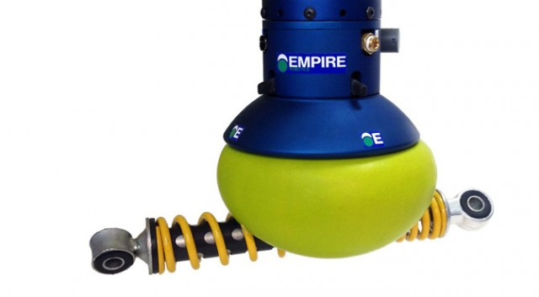
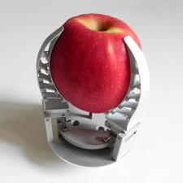
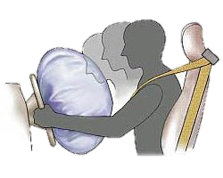
Previous Gripper Designs
Hard
Passive
Active
ERROR:
Too many grippers!
Soft
Notes:
Hard Passive: Bin, table tennis racket, wall, brick
Hard Active: Industrial grippers, e.g. MakeBlock
Soft Passive: Crumple zones, air bags, velcro
Soft Active: Coffee beans, Festo, Electro-adhesion, Pneumatics, Adaptive Compliance … and more!!!

Slide 5
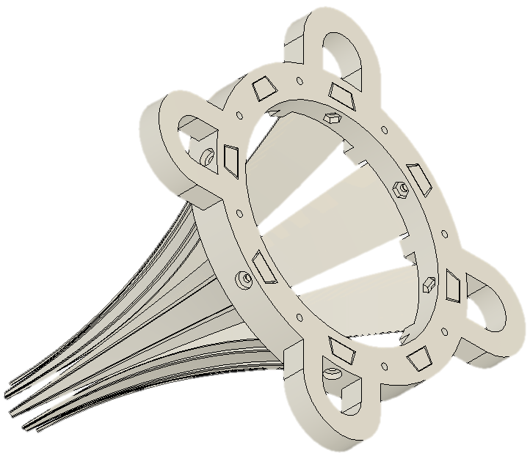
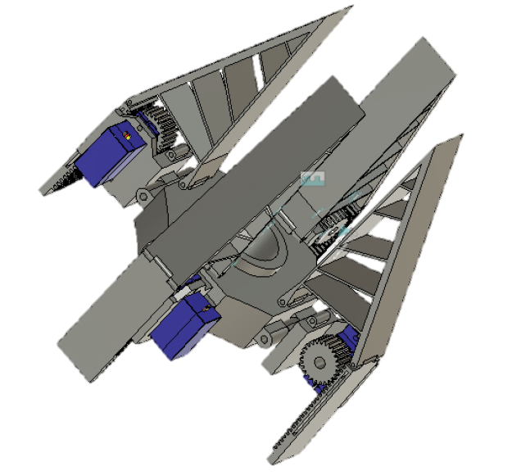
Our Gripper Designs
Active: Festo Fin Gripper
Requires knowledge of time to close just before the object hits the gripper
Passive: Funnel Catcher
Careful design, limited range of objects it can catch, reduced control complexity

Slide 6
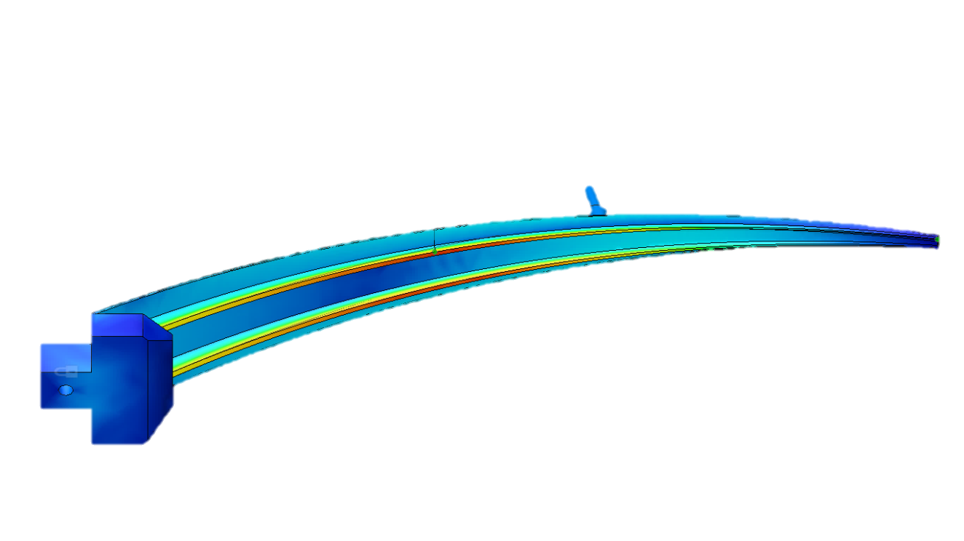
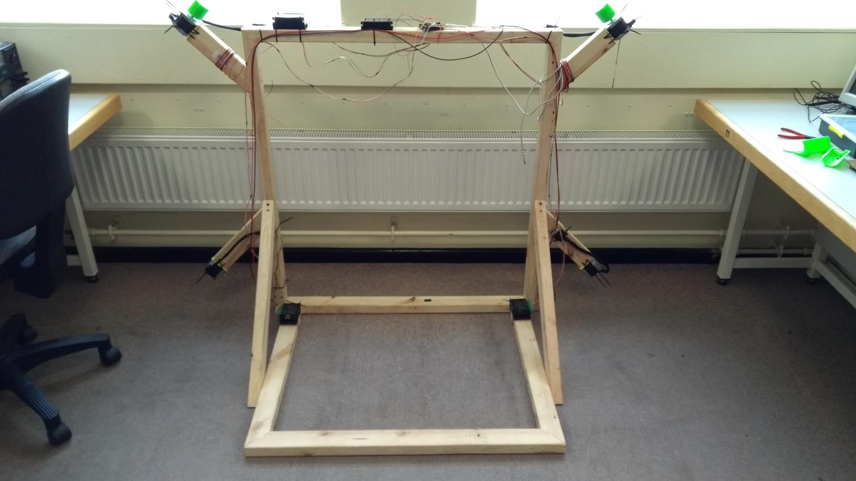
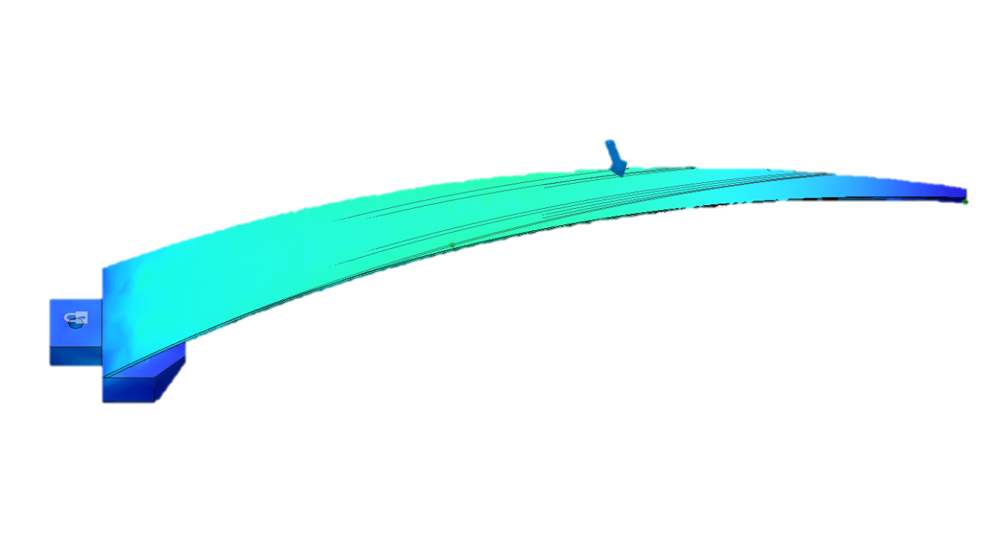
Design
Passive Gripper FEA
Active Gripper CAD
Frame
Motors…

Slide 7
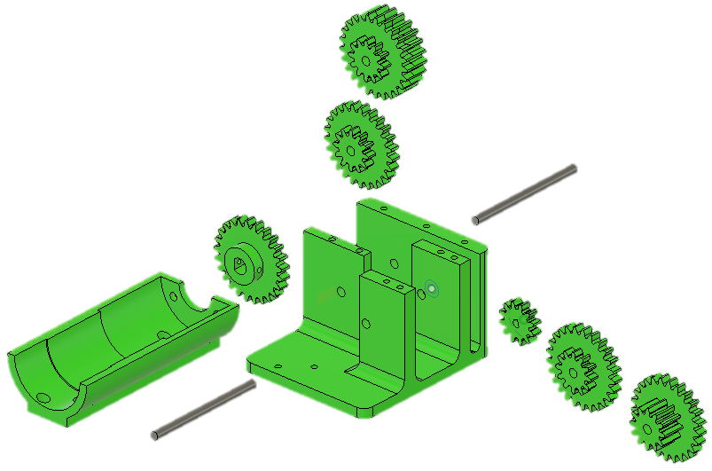
Motors
Problems
Gear Box:
Gears slipping and plastic failing
Reducing gear ratios
Increasing gear depths to increase surface area of contact between teeth
Reducing tolerances & adding blocks to reduce side movement
Strengthen gearbox design
Stepper Motor + Driver
Unable to deliver power and difficult to control
Attempted reusing an old controller via sniffing commands from an XP machine
Attempting to use different controllers

Slide 8
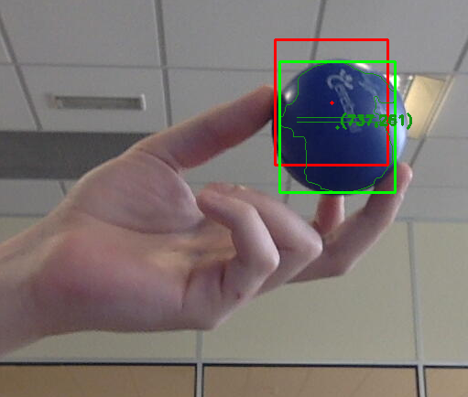
Object Tracking
Generic Algorithm
Attempted 3 algorithms
Histogram centric
Optical flow based
Neural-network inspired
Simple Algorithm
Colour detection with centre of mass
Integration with ROS

Slide 9
To Do
Look into image stabilization & Kalman filter
Finish system kinematics
Attempt PID control

Slide 10
Questions?

